Slide 1


Game & Simulation Technology
Patrick Wieczorek
12th January 2010

Slide 2
Agenda
Introduction
Features
Implementation
How it works
Summary
10 Jan 2011
XNA Console - Patrick Wieczorek - HTW-Berlin

Slide 3
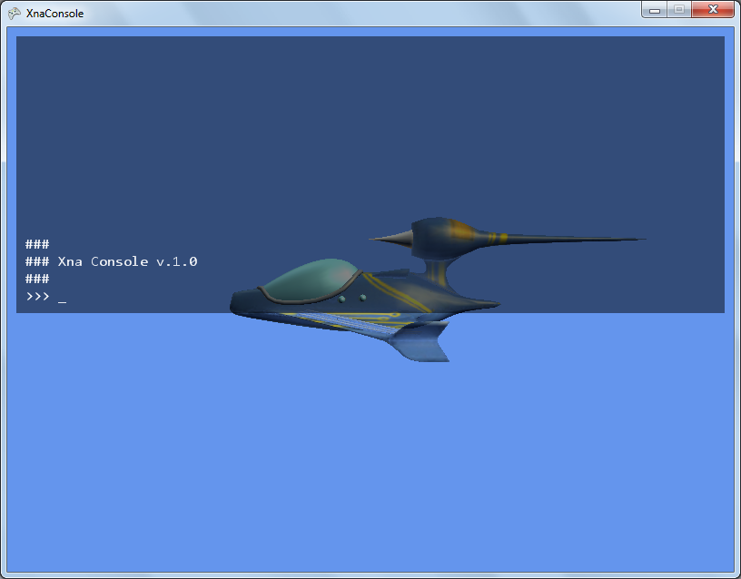
Introduction
Basic console
Uses IronPython as interpreter
Current release
Beta v. 1.01
8th Novemer 2008
Downloads: 954
10 Jan 2011
XNA Console - Patrick Wieczorek - HTW-Berlin

Slide 4
Introduction
XNA 3.0 compatible
License: no license
improvements may be published back
Developer: Shader (no real name)
last visit 27th November 2010
No maintainance, no license, no rules
Do whatever you want
10 Jan 2011
XNA Console - Patrick Wieczorek - HTW-Berlin
Notes:
freebee

Slide 5
Features
Read out variables
(Write to variables)
Other interpreters can be implemented
command history and cursor
10 Jan 2011
XNA Console - Patrick Wieczorek - HTW-Berlin

Slide 6
Implementation
Files /
  content/
    consola.ttf
    ConsoleFont.spritefont
  lib/
    IronMath.dll
    IronPython.dll
  KeyBindings.cs
  PythonInterpreter.cs
  XnaConsole.cs
10 Jan 2011
XNA Console - Patrick Wieczorek - HTW-Berlin

Slide 7
Implementation
Basic implementation in Game class
PythonInterpreter interp;
Initialize() {
interp = new PythonInterpreter(this, Content.Load<SpriteFont>("ConsoleFont"));
}
Registering variables
Initialize() {
…
int aNumber = 1;
interp.AddGlobal(„max“, aNumber);
}
10 Jan 2011
XNA Console - Patrick Wieczorek - HTW-Berlin

Slide 8
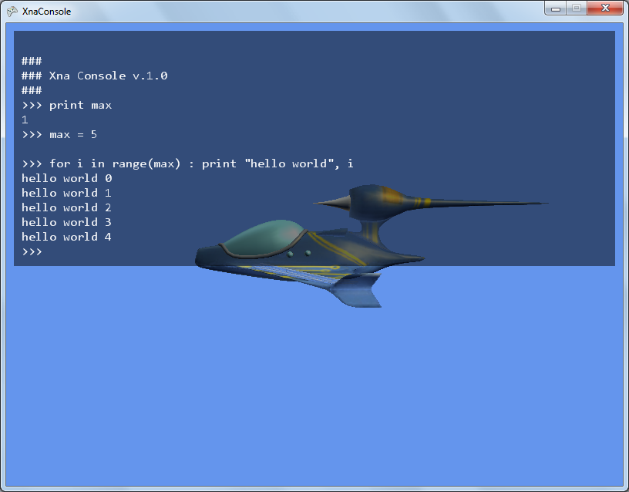

Implementation
10 Jan 2011
XNA Console - Patrick Wieczorek - HTW-Berlin

Slide 9
How it works
Console gathers keyboard input into string
On [Enter] PythonInterpreter.Execute(inputStr)
String is send to PythonEngine.Execute(inputStr)
Receive byte array via PythonEngine.Read(…)
Converted byte stream can be send to Console.WriteLine()
Back to beginning: console awaits input
10 Jan 2011
XNA Console - Patrick Wieczorek - HTW-Berlin

Slide 10
How it works
Other interpreters can be used
  An interface with basic methods is included
  Complexity depends on interpreters
10 Jan 2011
XNA Console - Patrick Wieczorek - HTW-Berlin

Slide 11
Summary
Pros
  Nice tool to check variable status
  Change attribute values
  Interpreters can be changed
Cons
  Only public and protected
  attributes can be read
  Changing attribute values in console
  can be a mess, e.g. changing Vector3 values
  Special characters crash game
10 Jan 2011
XNA Console - Patrick Wieczorek - HTW-Berlin
Notes:
No Documentation!

